Slide 1
15CSE201 : Data Structures and Algorithms
Lecture 14 :Graph Algorithms
Ritwik M
Based on the reference materials by Prof. Goodrich and Dr. Vidhya Balasubramanian

Slide 2
Introduction
This Presentation focuses on bringing visualizations to graph algorithms.
View in presentation mode for easier study

Slide 3
An Interesting Problem
A telecommunications company laying cable to a new neighborhood. It has to ensure that all the houses get cable connections.If it is constrained to bury the cable only along certain paths (e.g. along roads), some of those paths might be more expensive, because they are longer, or require the cable to be buried deeper. Currency is an acceptable unit here.
If you are a member of this company, how would you solve this problem with minimal cost?

Slide 4
Spanning Trees
Given a connected, undirected graph, a spanning tree of that graph is a sub-graph that is a tree and connects all the vertices together.
A single graph can have many different spanning trees
We can also assign a weight to each edge, which is a number representing how unfavorable it is, and use this to assign a weight to a spanning tree by computing the sum of the weights of the edges in that spanning tree

Slide 5
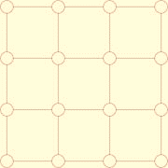
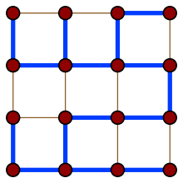
Exercise
Create a spanning tree for the following graph
Can you create more than one tree?

Slide 6
Minimum Spanning Tree (MST)
A minimum spanning tree (MST) or minimum weight spanning tree is then a spanning tree with weight less than or equal to the weight of every other spanning tree

Slide 7
Modelling the problem
The company is constrained to bury the cable only along certain paths (e.g. along roads), then there would be a graph representing which points are connected by those paths.
Some of those paths might be more expensive - these paths would be represented by edges with larger weights
The weight of the edges can be the currency
A spanning tree for that graph would be a subset of those paths that has no cycles but still connects to every house
A minimum spanning tree would be one with the lowest total cost, thus would represent the least expensive path for laying the cable

Slide 8
Solutions:
There are different algorithms to find the minimum spanning tree from a graph.
A few of the famous ones are:
Prim’s algorithm
Kruskal’s algorithm
Borůvka's algorithm

Slide 9
Prim’s Algorithm
Algorithm Prims(G,v)
Initialize a tree with a single vertex, chosen arbitrarily from the graph.
Grow the tree by one edge: of the edges that connect the tree to vertices not yet in the tree, find the minimum-weight edge, and transfer it to the tree.
Repeat step 2 (until all vertices are in the tree).

Slide 10
Pseudocode:
Input: A non-empty connected weighted graph with vertices V and edges E (the weights can be negative).
Initialize: V_{new} = {x}, where x is an arbitrary node (starting point) from V, E_{new} = {}
Repeat until V_{new} = V:
Choose an edge {u, v} with minimal weight such that u is in V_{new} and v is not (if there are multiple edges with the same weight, any of them may be picked)
Add v to V_{new}, and {u, v} to E_{new}
Output: V_{new} and E_{new} describe a minimal spanning tree

Slide 11
Visualization

Slide 12
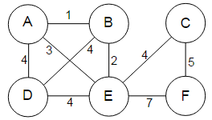
Exercise
Perform prim’s algorithm to find the minimum spanning tree for the following graph

Slide 13
Kruskal’s Algorithm
Description:
1. create a forest F (a set of trees), where each vertex in the graph is a separate tree
2. create a set S containing all the edges in the graph
3. while S is nonempty and F is not yet spanning
4. remove an edge with minimum weight from S
5. if the removed edge connects two different trees then add it to the forest F, combining two trees into a single tree

Slide 14
Kruskals Algorithm

Slide 15
Kruskal’s Algorithm
Pseudocode:
KRUSKAL(G):
1 A = ∅
2 foreach v ∈ G.V:
3 MAKE-SET(v)
4 foreach (u, v) ordered by weight(u, v), increasing:
5 if FIND-SET(u) ≠ FIND-SET(v):
6 A = A ∪ {(u, v)}
7 UNION(u, v)
8 return A

Slide 16
Exercise
Perform Kruskal’s algorithm to find the minimum spanning tree for the following graph.

Slide 17
Borůvka's algorithm
boruvkaAlgorithm(graph, weight)
SpanningTree tree //spanning tree
components = graph.vertices //at the beginning every
vertex is a component
while components.size > 1 do
for each component in components
edge e = connectWithMinimalEdge(component, weight) //connect with some other component using a minimal edge
tree.add(e) //add the edge into the spanning tree
return tree

Slide 18
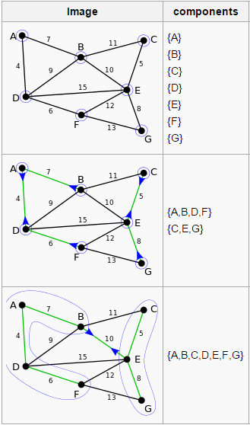
Example
Source: wiki

Slide 19
Example cont.
Source:

Slide 20
Example cont.
Source: wiki

Slide 21
Use

Slide 22
Shortest Path
The problem:
Finding a path between two vertices (or nodes) in a graph G(V,E) such that the sum of the weights of its constituent edges is minimized

Slide 23
Shortest Path
Types:
Single - Source Shortest Paths
Dijkstra's algorithm – O(V²,O((E+V)logV))
Bellman–Ford algorithm – O(VE)
All – Pairs Shortest Path
Floyd-Warshall algorithm - O(V³)

Slide 24
Dijkstra’s Algorithm
For each vertex v in Graph: // Initialization if v ≠ source // Where v has not yet been removed from Q (unvisited nodes)
dist[v] ← infinity // Unknown distance function from source to v
prev[v] ← undefined // Previous node in optimal path from source
end if
add v to Q //All nodes initially in Q (unvisited nodes)
End For
While Q is not empty:
u ← vertex in Q with min dist[u] // Source node in first case
remove u from Q
for each neighbor v of u: // where v is still in Q.
alt ← dist[u] + length(u, v)
if alt < dist[v]: // A shorter path to v has been found
dist[v] ← alt
prev[v] ← u
end if
end for
End While

Slide 25
Dijkstra’s Algorithm
Animation

Slide 26
Bellman – Ford Algorithm
Pseudocode:
function BellmanFord(list vertices, list edges, vertex source)
::distance[],predecessor[]
// Step 1: initialize graph
// Step 2: relax edges repeatedly
// Step 3: check for negative-weight cycles

Slide 27
Bellman – Ford Algorithm
// Step 1: initialize graph
for each vertex v in vertices:
if v is source then distance[v] := 0
else distance[v] := inf
predecessor[v] := null

Slide 28
Bellman – Ford Algorithm
// Step 2: relax edges repeatedly
for i from 1 to size(vertices)-1:
for each edge (u, v) with weight w in edges:
if distance[u] + w < distance[v]:
distance[v] := distance[u] + w
predecessor[v] := u

Slide 29
Bellman – Ford Algorithm
// Step 3: check for negative-weight cycles
for each edge (u, v) with weight w in edges:
if distance[u] + w < distance[v]:
error "Graph contains a negative-weight cycle"
return distance[], predecessor[]

Slide 30
Floyd -Warshall
Description
Let the vertices in a graph be numbered from 1..n. Consider the subset {1,2,…, k} of these n vertices.
Imagine finding the shortest path from vertex i to vertex j that uses vertices in the set {1,2,…,k} only.
There are two situations:
k is an intermediate vertex on the shortest path.
k is not an intermediate vertex on the shortest path.
k
i
j

Slide 31
Floyd - Warshall
Pseudocode:
for i = 1 to N
for j = 1 to N
if there is an edge from i to j
dist[0][i][j] = the length of the edge from i to j
else
dist[0][i][j] = INFINITY
for k = 1 to N
for i = 1 to N
for j = 1 to N
dist[k][i][j] = min(dist[k-1][i][j], dist[k-1][i][k] + dist[k-1][k][j])

Slide 32
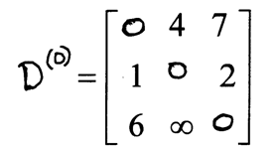
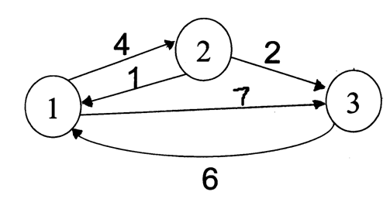
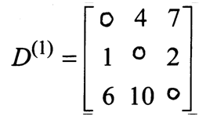
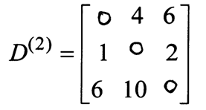
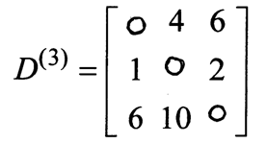
Floyd - Warshall Example
s
Original weights.
Consider Vertex 1:
D(3,2) = D(3,1) + D(1,2)
Consider Vertex 2:
D(1,3) = D(1,2) + D(2,3)
Consider Vertex 3:
Nothing changes.
Source: http://www.cs.ucf.edu/~dmarino/ucf/cop3503/lectures/

Slide 33
Floyd – Warshall Algorithm
An excellent animation:
https://www.cs.usfca.edu/~galles/visualization/Floyd.html

Slide 34
END

